Slide 1



Budget
Bites
CSC207-G90
Notes:
Welcome Professor ____ and Amogh to our CSC207 Final Project Presentation
Today we are going to unveil a program that will be real game changer in the food delivery industry which is also specifially designed for Uoft students
We present to you all BudgetBites

Slide 2


Problem in the World
Students struggle with managing school, careers, hobbies, and time. Students are also under the stress of paying tuition and living costs. After a long day at school, finishing difficult assessments and exams, who would want to come home to buy groceries and make food? To ensure that we can come home to a great meal where you don’t need to pay a fortune for your food, we introduce to you…
Notes:
Being a university student, it is very difficult balancing time for attending lectures, doing schoolwork, pursuing hobbies, and sleeping and using end up trying to make up this time through various ways.
Some do it by sleeping 4 hours a day and some do so by ordering out whenever they are feeling hungry
Now the second solution to our time problem also puts us in a new predicament, which is that we also do not have enough money to constantly be eating out, but we usually result to it since as no one wants to buy groceries and make food after finishing a stressful day of assessments and exams
Now to ensure that our fellow peers at Uoft are not going to be both sleep deprived and starving in class by being able to order meals while also keeping track of their financial well-being we introduce our program BudgetBites

Slide 3
User Sign Up or Login
User Preferences
BudgetBites
Food Suggestion
UofT-based Java Desktop application that allows its users to find budget-friendly food options.
Managing Budget

Slide 4
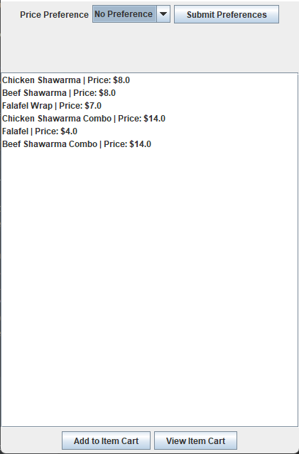


BACKEND SPECIFICATIONS
FRONTEND SPECIFICATIONS
User Registration
User Login
Restaurant Filtering
Price Filtering
Item Cart
Ordering
User Budget
Food Suggestion
BY MIKOKIT
-[
F
I
L
]-
Notes:
nathan

Slide 5
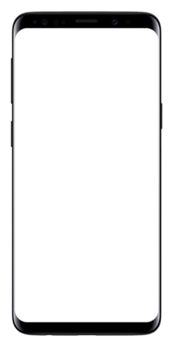

Sign Up
Calls Use Case Interactor Methods
SignUpInteractor
(Use Case)
Controller
User Factory
Output Boundary
Data Access Interface
Updates
Presenter
MainMongoDB
User
Interface
JFrame

Slide 6

Challenges Faced When Implementing: User Registration
Challenge:
No use of design patterns
Disregarding SOLID Principles; specifically open/close principle
Accurately saving all inputs given by user
Solution:
Added UserBuilder
Created such that new classes can be extended in the future
took save user out of conditional
Notes:
Vandan
The User class is another example of this principle as we are able to keep this User as the base User object, and if necessary, later we can have other classes such as NewUser or LoggedInUser to extend these classes to match the functionality with potentially added functionality.

Slide 7
Log In
Calls Use Case Interactor Methods
LoginInteractor
(Use Case)
LoginController
User Factory
Output Boundary
Login Data Access Interface
Updates
LoginPresenter
MainMongoDB
User
Interface
JFrame
Notes:
User inputs the email and password.

Slide 8
Challenges Faced When Implementing: Log In
Challenge:
- Ensuring that User data is used stored throughout the application
- We were not making use of all the SOLID principle, specifically the Dependency Inversion Principle
Solution:
- To fix this, we stored the Username, as an instance attribute on each frame.
- Added the Login DAI, so that the Use Case does not call the Database directly.
RestaurantListFrame
- currentUser: String
…..
…..
Notes:
Vandan
The User class is another example of this principle as we are able to keep this User as the base User object, and if necessary, later we can have other classes such as NewUser or LoggedInUser to extend these classes to match the functionality with potentially added functionality.

Slide 9
Restaurant Filtering
RestaurantFilterController
Calls Use Case Interactor Methods
Restaurant Filter
Output Boundary
RestaurantFilterPresenter
Data Access Interface
Updates
MainMongoDB
User
Interface
JFrame
Notes:
Darpan

Slide 10
Challenges Faced When Implementing: Restaurant Filtering
SOLID:
Interface Segregation:
Classes that interact with a presenter interface use all the methods. The interface is specific
Code Smell:
Long Method in RestaurantFilter use case. Filter method has many if statements.
Challenge:
Learning to implement Clean Architecture
Notes:
Restaurant Filter

Slide 11
Price Filtering
Calls Use Case Interactor Methods
priceFilter
(Use Case)
FoodItemsController
Output Boundary
FoodItemsDAI
(Data Access Interface)
Updates
foodItemsPresenter
MainMongoDB
User
Interface
JFrame

Slide 12
Challenges Faced When Implementing: Price Filtering
Challenges:
One challenge was implementing Clean Architecture and properly accessing the database without dependency inversions.
Solutions:
Creating proper flow for the entire use case and that does not violate or skip over any clean architecture layers. For example, as outlined in the flow diagram of the implementation.
Another challenge was properly filtering through the menu of the restaurant selected by the user.
Notes:
darpan

Slide 13
ItemCart
Calls Use Case Interactor Methods
ModifyItemCartInteractor
(Use Case)
ModifyItemCartController
ItemCart (Entity)
Output Boundary
MakeOrderDAI(Data Access Interface)
Updates
ModifyItemCartPresenter
MainMongoDB
User
Interface
JFrame

Slide 14
Challenges Faced When Implementing: ItemCart
When doing Clean Architecture, I needed to operate on the FoodItem object but only had access to the string names of food items.
Made a method to associate string to the particular FoodItem object and used the Iterator design pattern CurretOrderIterator to iterate through the food items in the item cart to implement accumulation methods like finding the total cost of the cart and getting a list of names of food items in the cart.
Notes:
Aviral

Slide 15
Budgeting
Calls Use Case Interactor Methods
BudgetingInteractor
(Use Case)
BudgetController
Entities
Output Boundary
BudgetDAI:
Data Access Interface
Updates
Presenter
MainMongoDB
User
Interface
JFrame
Notes:
Now we head over to the budgeting part of our app. after the user has placed their order they are now directed to this user page frame which displays the user profile information which includes their budget which was all implemented through clean architecture as shown by our flow diagram, now back to the app from here our user can also decide to change their monthly budget which they can do by clicking the change budget button, they can now change their monthly budget however it will not allow them to do so I there username is not in the database or if there new budget and confirm budget are not the same now that we have changed the budget as you can see the monthly budget has been updated and the current budget is also adjusted accordingly

Slide 16

Challenges Faced When Implementing: Budgeting Feature
Challenge:
Multiple Code Smells throughout the implementation of my initial code
Disregarding SOLID Principles; specifically Single Responsibility Principle
Solution:
Identifying Code Smells: Large Class
Extracting classes and following Single Responsibility Principle when doing so
Notes:
Akshayan
As I was developing my part of the program, I continuously wanted to have a working product, which lead me to disregarding many code smells that appeared in my code which led me to falling into the trap of creating a ginormous class, which had essentially held all the functionality budgeting features. In order to fix this issue, I started refactoring the code by extracting subclasses from this huge class, which in the long run not only made my code more cleaner, but helped me remove any instances where there was duplicate code. Following the single responsibility principle in this case had also helped me when I was extracting the classes, as it made me make sure that after I refactored my code to double check and ensure that every class only had one job to do

Slide 17
PastOrders
Calls Use Case Interactor Methods
PastOrderInteractor
(Use Case)
PastOrderController
Entities
Output Boundary
Data Access Interface
Updates
PastOrderPanel
(Presenter)
MainMongoDB
User
Interface
JFrame

Slide 18

Challenges Faced
Clean architecture: the controller was not calling the use case
Code Smell Resolved: Alternative Classes with Different Interfaces, Data Class
Design decision: Making PastOrders an entity
SOLID: Single Responsibility Principle, Dependency Inversion Principle
Notes:
Aryan

Slide 19
Food Suggestion
Calls toPresenter
(Method)
SuggestionToUser
(Interactor)
FoodSuggestions
(Controller)
IFoodSuggestionsPresenter
Output Boundary
SuggestionToUser DAI
Calls via FoodSuggestionsViewer
Presenter
MainMongoDB
(Gateway)
User
Interface
JFrame

Slide 20

Challenges Faced When Implementing: Food Suggestions
Challenge:
Code smells: Change Preventers
Hard Dependencies
Solution:
Dependency Injection
MVC Model
Notes:
Akshayan
As I was developing my part of the program, I continuously wanted to have a working product, which lead me to disregarding many code smells that appeared in my code which led me to falling into the trap of creating a ginormous class, which had essentially held all the functionality budgeting features. In order to fix this issue, I started refactoring the code by extracting subclasses from this huge class, which in the long run not only made my code more cleaner, but helped me remove any instances where there was duplicate code. Following the single responsibility principle in this case had also helped me when I was extracting the classes, as it made me make sure that after I refactored my code to double check and ensure that every class only had one job to do

Slide 21

Use of MongoDB
MVC Architecture
Major Design
Decisions
ItemCart + PastOrder Entity
Use of Javaswing
Notes:
Darpan

Slide 22

CODE STYLE
PACKAGING
GITHUB
ACCESSIBILITY
All warnings were resolved.
Documented all necessary methods using Javadocs and added comments in non-trivial or hard to understand code.
Followed consistent Java naming conventions based on Milestone 4 feedback
Code is organized in a meaningful way. Easy to follow package structure.
Implemented a By Layer packaging by use case structure where code is organised with respect to the clean architecture layer it belongs to.
Used several GitHub features such as pull requests, actions, issues, project to optimize the team's workflow.
All PRs followed consistent title style and included a list of modifications made.
Mainly used issues, project and branches to resolve conflicts, and track changes.
Thoroughly followed the 7 principles of universal design to account for the accessibility needs of our audience.
Some of such features include flexibility in user preferences, user-friendly UI. Contrast between information and background, back buttons in case of misclicks, etc.
Notes:
Janel

Slide 23


Testing
Provided extensive testing
Tested corner cases
Ensured to check cases that not only pass but also fail
Tested all entities through getter and setter methods
William
Notes:
Mann

Slide 24
USE OF GITHUB FEATURES
72
6
89
ISSUSES
MAJOR DISCUSSIONS
PULL REQUESTS
We created issues to split the project in big tasks
Used to discuss design decisions and implementation changes
were used to combine individual work into a group app
Notes:
Aryan

Slide 25
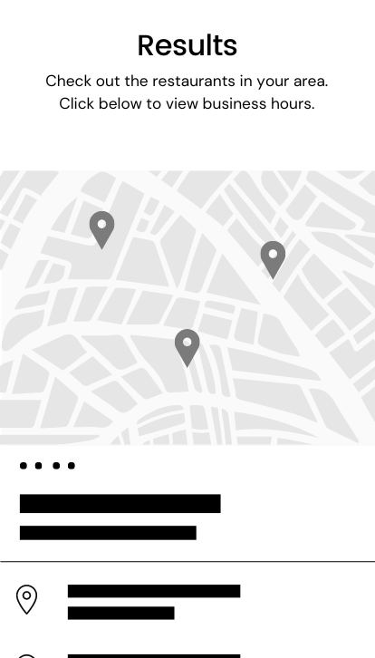

Accessibility
Increase the target audience
Make application simple and intuitive
Add Text to Speech Functionality
FUTURE OF BUDGETBITES
Functionality
Add more functions and improve
existing functions Take runtime into consideration
Open Close Principle
Notes:
Vandan

